Slide 1
Software Design and Architecture (SE:2002)
Course Instructor: Romasha Khurshid
Email Address: Romasha.Khurshid@nu.edu.pk
Reference Book: Applying UML and Patterns (An introduction to Object-Oriented Analysis and Design And Iterative Development)
BY Craig Larman
Third Edition

Slide 2
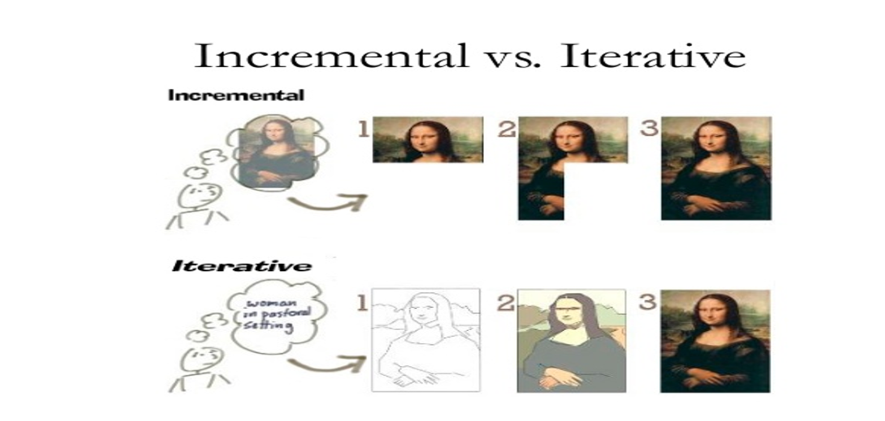
Software Development Models:

Slide 3
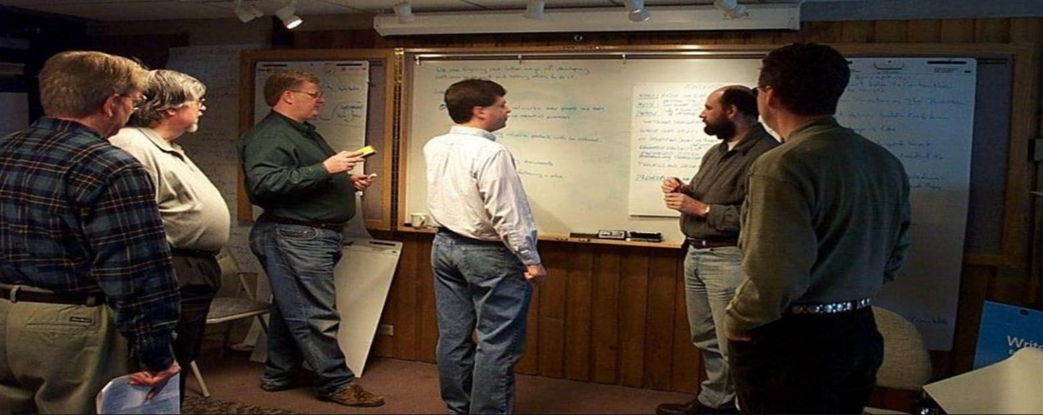
Agile Mindset:
And agile was born … 2001

Slide 4
Agile Manifesto:
We are uncovering better ways of developing software by doing it and helping others do it. Through this work we have come to value:
Individuals and interactions over processes and tools
Working software over comprehensive documentation
Customer collaboration over contract negotiation
Responding to change over following a plan
“That is, while there is value in the items on the right, we value the items on the left more.”

Slide 5
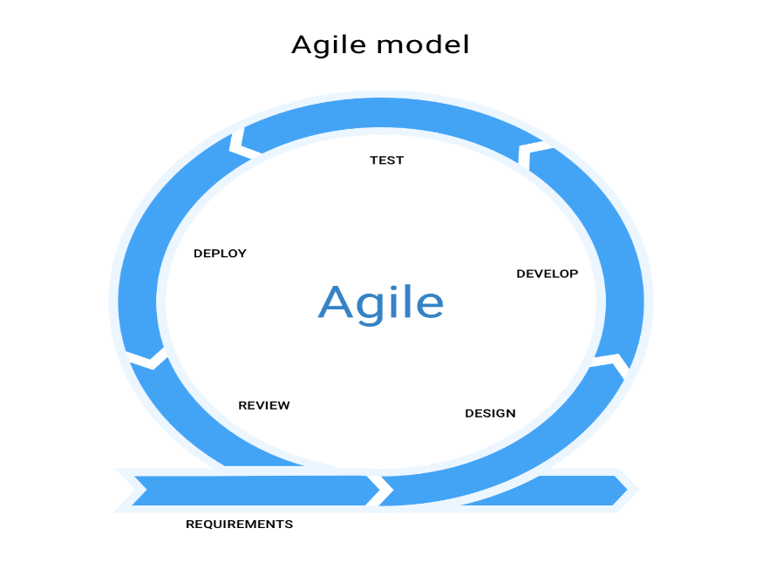
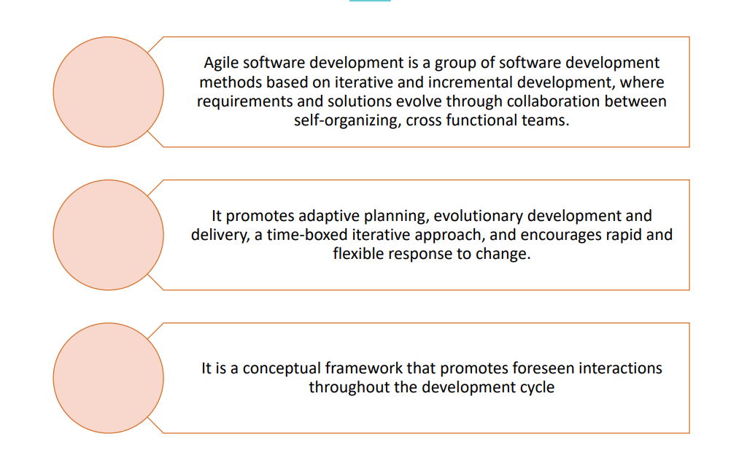
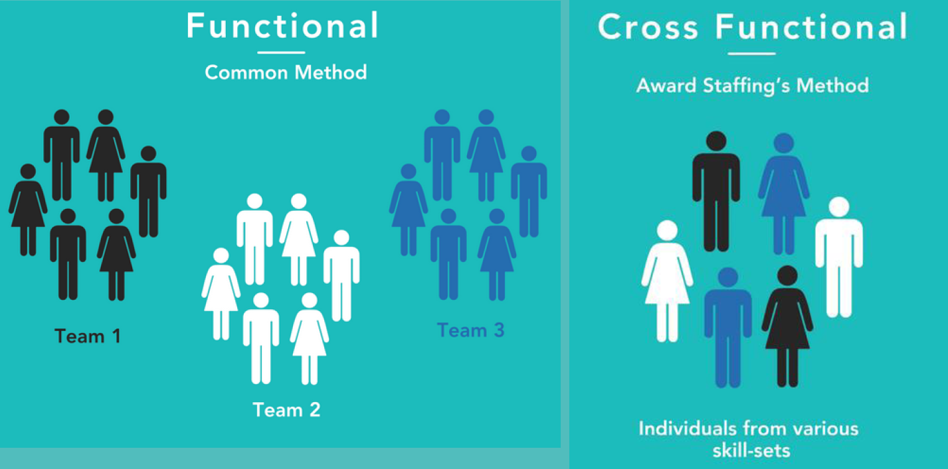
What is Agile?

Slide 6
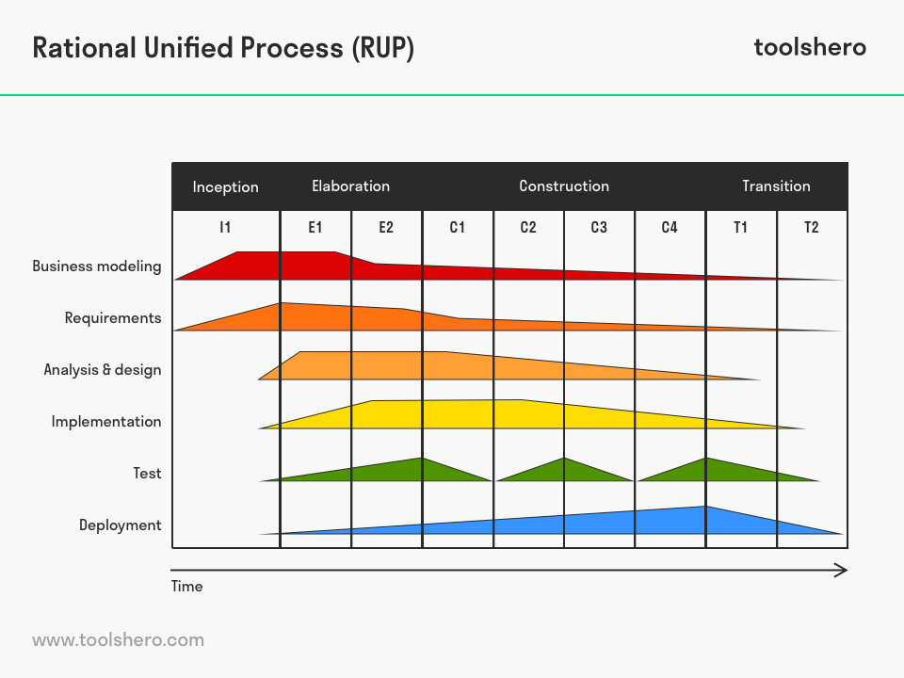

Unified Process:
It is an iterative approach
UP encourages risk-driven and client-driven iterative planning.
Phases and disciplines.

Slide 7
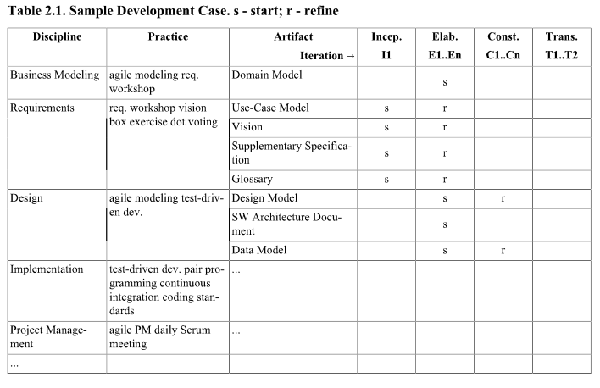
Development Case:

Slide 8

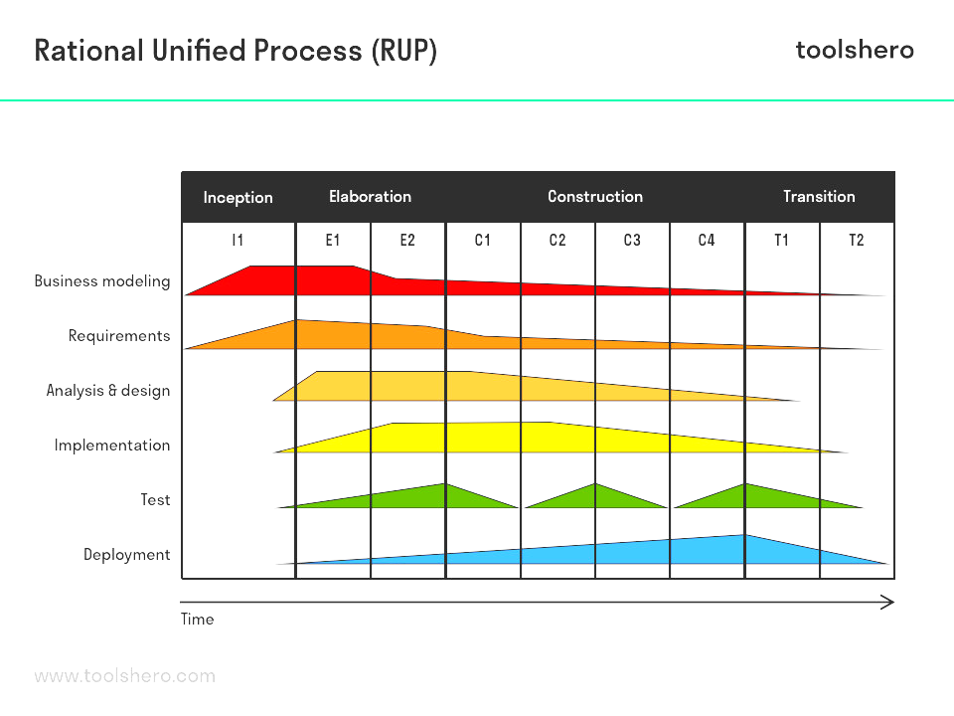

Unified Process:
Inception:
What is the vision and business case for this project?
Feasible?
Buy or build?
Rough estimates of cost and time?
Artifacts:
Business Case or Vision Artifacts
High-level Use-Case diagram

Slide 9
Unified Process:
Elaboration:
Requirements Specification
Validate Architecture
Establish Executable Architecture
Figure out risks
Artifacts:
Domain Model
Descriptive Use-Cases

Slide 10
Unified Process:
Construction: (Release)
Largest phase
Software construction
Iterative and incremental

Slide 11
Unified Process:
Transition: (Final Production Release)
Deployment
Stakeholder Feedback
User Training

Slide 12
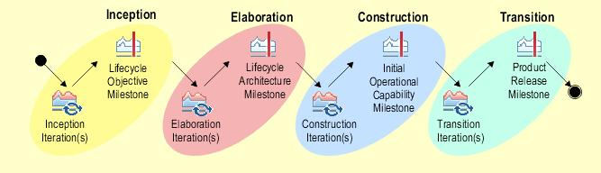
Characteristics:
It is a framework
Architecture Centric
User centric
Focus on risk mitigation

Slide 13

Predictive or Adaptive?

Slide 14

Unified Process:
Pros:
Adaptive Process
Risk mitigation
Quality
Flexible incorporate with other models.
Cons:
Complex framework
Overheads
Use:
For riskier projects
Requirements not known in early stages
Deliver value first

Slide 15
UP Artifacts:
Business Modeling: the domain model artifact
Requirements: The Use-Case model artifact
Design: The design model artifact

Slide 16
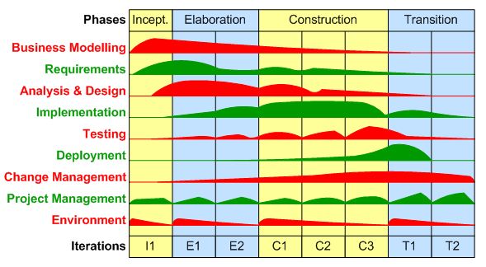
Rational unified Process: (RUP)
Most Popular Variant of UP.
RUP was evolved into AUP by Scott ambler.
4 phases, 9 key disciplines.

